Slide 1
INFO 6210 DATA MANAGEMENT AND DATABASE DESIGN
Team 3
Members:
Richa Bhatia
Sanket Kumar
Virag Zaveri

Slide 2
Project Topic: Database Design for Kayak.com
Key points
Designed a system to allow Kayak.com to conduct its operations and provide the customers with various services such as Hotel bookings, Car rentals, bus and flight reservations
Customers can search for services, select the desired services and make payment for their booking
Customers can track their history while gaining bonus points for using Kayak

Slide 3
Features used for Analysis
Search history of users to determine which service is most popular, which flight route has most interest, which hotel has most interest etc.
Login history of users to determine the most popular days and time of site visit. Note no personal data of users is stored for analysis except user id
Booking data of users utilized to determine the most popular discount codes offered by Kayak along with the prices paid by customers

Slide 4
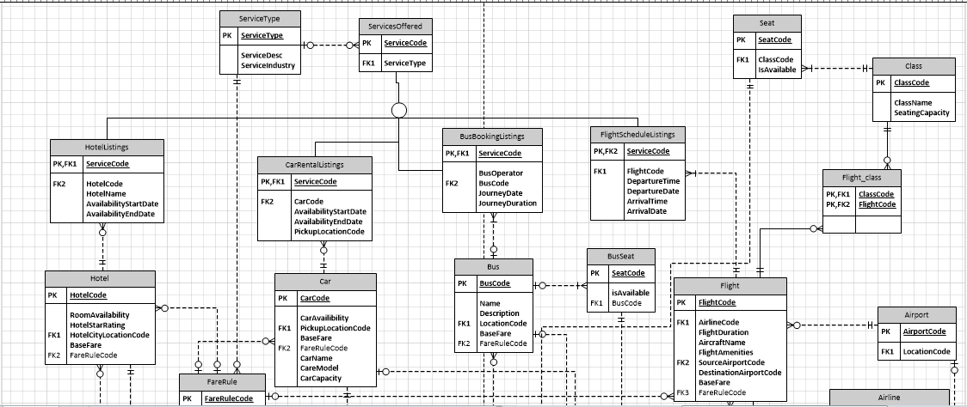
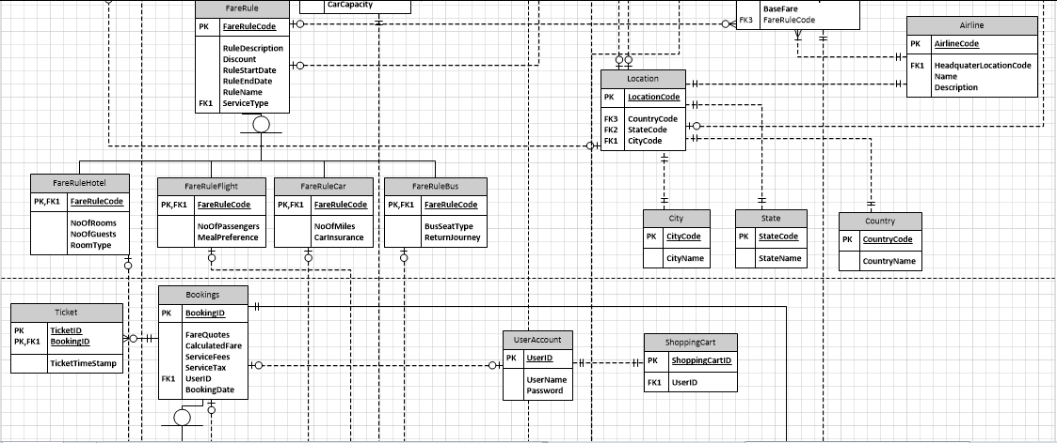
Database ERD Snapshot

Slide 5
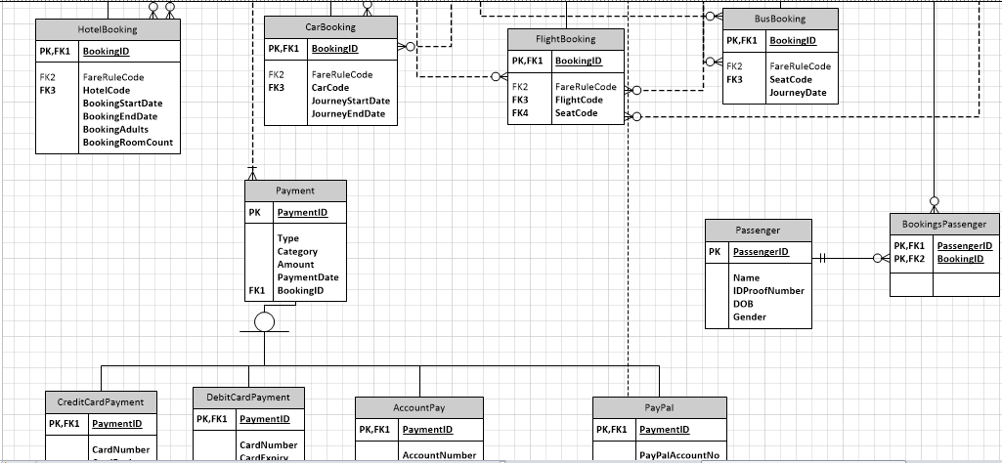
Database ERD Snapshot

Slide 6
Database Implementation Features
Computed Columns
Table Column Encryption
Triggers
Unique Constraints
Table level constraints
Pivot
Views
Stored Procedures

Slide 7
Computed Columns
Calculating age of Passenger from DOB
alter table Passenger add Age as CONVERT(int,DATEDIFF(hour,DOB,GETDATE())/8766) ;

Slide 8
Computed Columns
Calculating final payable amount and Bonus Points Earned by Customer
alter table bookings
add FareQuote as ServiceFees+ServiceTax;
alter table bookings
add BonusPointsEarned as 0.1*CalculatedFare;
alter table bookings
add BonusPointEarnDate as BookingDate;

Slide 9
Table Column Encryption
CREATE MASTER KEYENCRYPTION BY PASSWORD = 'Group3Password';
CREATE CERTIFICATE TestCertificateWITH SUBJECT = 'MYProject Certificate',EXPIRY_DATE = '2020-10-31';
CREATE SYMMETRIC KEY TestSymmetricKeyWITH ALGORITHM = AES_128ENCRYPTION BY CERTIFICATE TestCertificate;
OPEN SYMMETRIC KEY TestSymmetricKeyDECRYPTION BY CERTIFICATE TestCertificate;
ALTER TABLE UserAccount ADD password2 varbinary(250);
UPDATE UserAccountSET password2 = CONVERT(varbinary(MAX),password);
ALTER TABLE UserAccount DROP COLUMN password;
sp_RENAME 'UserAccount.[password2]' , 'Password', 'COLUMN';
Also Added Encryption for Card Number, Card PIN and Card CVV in DebitCardPayment and Credit Card Payment.
Also Encrypted Account Number in AccountPay along with PayPalAccount details

Slide 10
Triggers

Slide 11
Unique Constraints
ALTER TABLE City
ADD CONSTRAINT City_NoDuplicateValues UNIQUE (CityName);
ALTER TABLE State
ADD CONSTRAINT State_NoDuplicateValues UNIQUE (StateName);

Slide 12
Pivot

Slide 13
Stored Procedure - Hotels

Slide 14
Stored Procedure - Flight

Slide 15
Stored Procedure - Bus

Slide 16
Views – Booked Buses

Slide 17
Views – Booked Cars

Slide 18
Views – Booked Hotels

Slide 19
Views – Booked Flights

Slide 20
Views – Revenue Per Year

Slide 21
Views – Revenue Per Month

Slide 22
Views – Revenue By Service

Slide 23
Views – Flights above Avg Price

Slide 24
Views – Active Promo Codes

Slide 25
Power BI Bookings Report
https://app.powerbi.com/groups/me/reports/a79f7d6a-fa74-4471-9373-ee92b302ae12/

Slide 26
Power BI User Report
https://app.powerbi.com/groups/me/reports/e541eb1b-3de6-47c8-9f5f-613da560e38b/ReportSection1

Slide 27
Power BI Revenue Report
https://app.powerbi.com/groups/me/reports/a79f7d6a-fa74-4471-9373-ee92b302ae12/ReportSection

Slide 28
Thank You!

